Slide 1
Intelligent Tutoring Systems
DLTI-2

Slide 2
Introductions
● William Wu
○ 3rd year CS major
○ Java, Python, React, HTML, CSS, JavaScript, SQL
● Camille Bossut
○ 2nd year CS major
○ Java, Python, C++, Arduino, Matlab
● Ting Qiu
○ 3rd year CS major
○ Java, C, Python, SQL, Matlab, HTML
● Will Smith
○ 2nd year CS major
○ Java, Python
Notes:
Introduce our team members.
Introduce our the background of us. (new members to VIP, members have limited experience and knowledge about JavaScript and JSXgraph.)
What we did this semester.(Improve on the DLTI lab, work together on GitHub)

Slide 3
Objective
To improve user experience in the DLTI GUI used within the frequency response lab

Slide 4
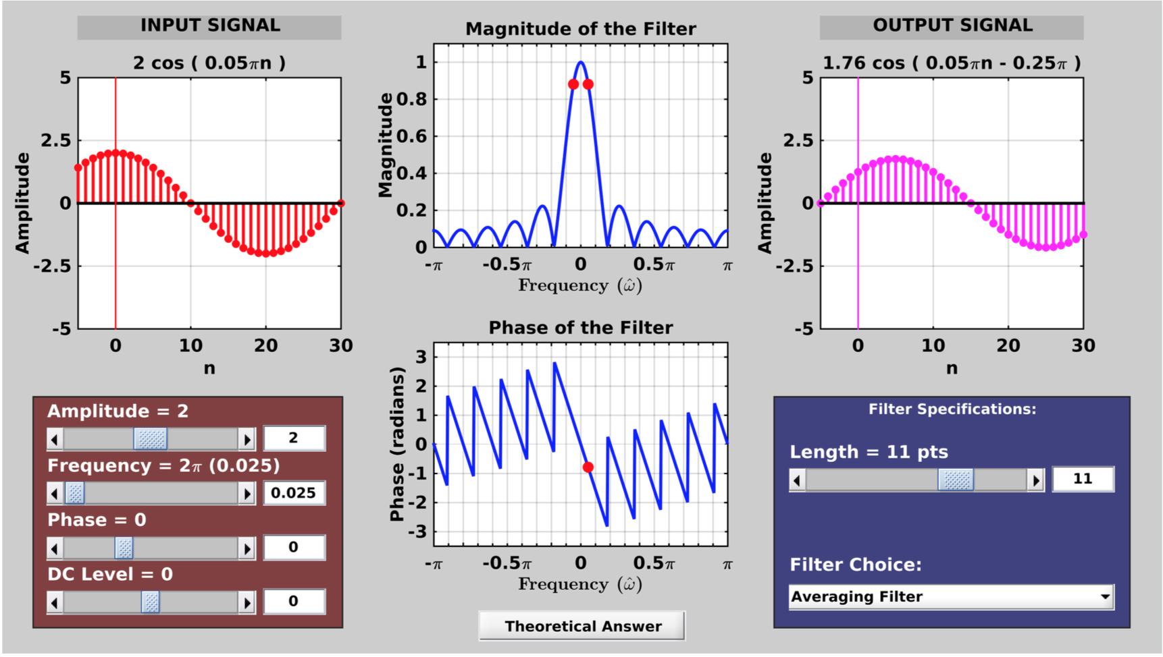
Project Motivation
Simple
Easy access to GUIs without Matlab
Learn how to use JavaScript and JSXgraph

Slide 5
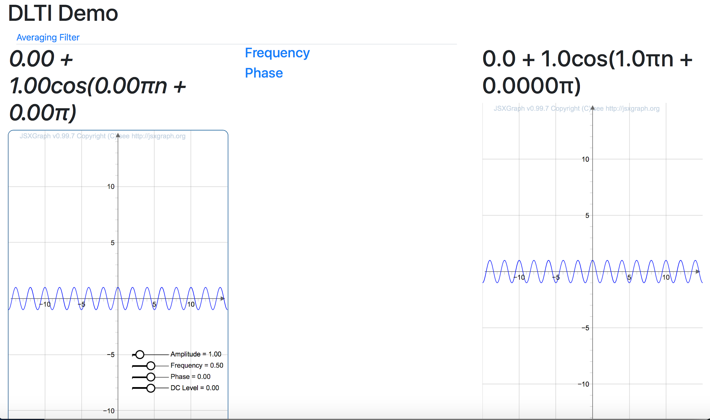
How did we want to improve?
Page layout
Controller functionality
Add Frequency and Phase graphs
Add more Frequency Response filters
Have a universal controller
Post/Get GUI state

Slide 6
Progression and Details

Slide 7
Splitting up the work
Option 1 : Front-end versus Back-end
However, most of the GUI is front-end
Different portions of code might be incompatible
Option 2 : Different portions of the GUI
Easier to group together
Avoids conflicts when using version control tools like git
Notes:
Split up on type of work? (front-end vs. back end)
Split up on part of work? (different portions of the GUI)
Latter ended up being more helpful, though we did need some front-end specialization
+screenshots of original gui and portions we could separate conceptually
+ccl: probably should have done more theory stuff to have a better idea of what we could split up

Slide 8
Splitting up the work
Graphs:
Input and Output
Camille
Page Layout and Controllers
William W. and Ting
Will S.
Graphs:
Filter Phase and Magnitude
Notes:
Split up on type of work? (front-end vs. back end)
Split up on part of work? (different portions of the GUI)
Latter ended up being more helpful, though we did need some front-end specialization
+screenshots of original gui and portions we could separate conceptually
+ccl: probably should have done more theory stuff to have a better idea of what we could split up

Slide 9
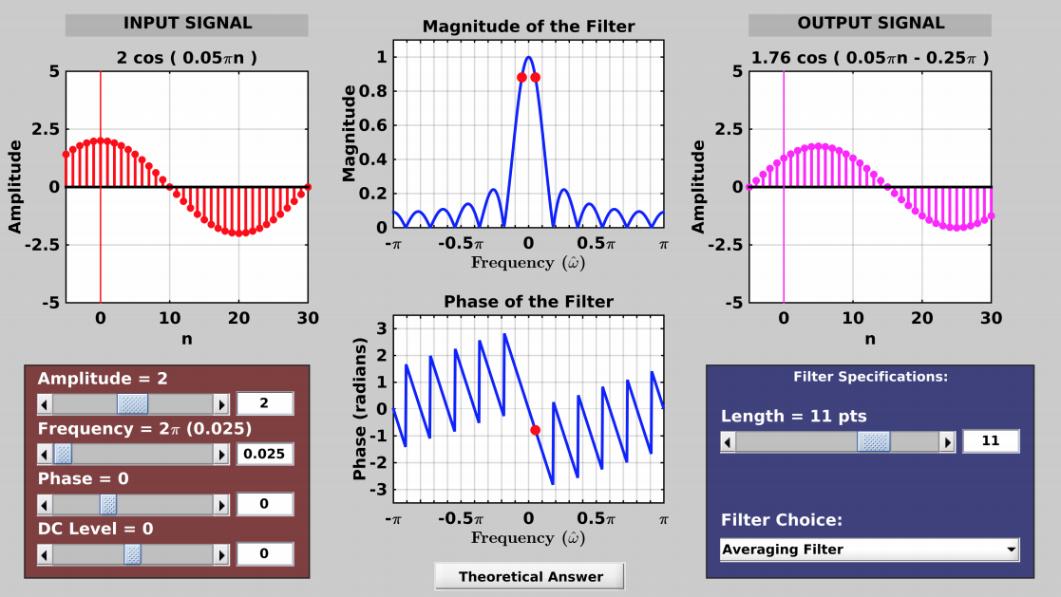
Splitting up the work — original GUI
Notes:
Split up on type of work? (front-end vs. back end)
Split up on part of work? (different portions of the GUI)
Latter ended up being more helpful, though we did need some front-end specialization
+screenshots of original gui and portions we could separate conceptually
+ccl: probably should have done more theory stuff to have a better idea of what we could split up

Slide 10
Splitting up the work — original GUI
These graphs are similar, so a similar plotting function may be used for both
Notes:
Split up on type of work? (front-end vs. back end)
Split up on part of work? (different portions of the GUI)
Latter ended up being more helpful, though we did need some front-end specialization
+screenshots of original gui and portions we could separate conceptually
+ccl: probably should have done more theory stuff to have a better idea of what we could split up

Slide 11
Splitting up the work — original GUI
These graphs use formulas given that we could plug into a JSX ‘curve’ object
Notes:
Split up on type of work? (front-end vs. back end)
Split up on part of work? (different portions of the GUI)
Latter ended up being more helpful, though we did need some front-end specialization
+screenshots of original gui and portions we could separate conceptually
+ccl: probably should have done more theory stuff to have a better idea of what we could split up

Slide 12
Splitting up the work — original GUI
Controllers and general layout of the page can be reproduced without specific graph information
Notes:
Split up on type of work? (front-end vs. back end)
Split up on part of work? (different portions of the GUI)
Latter ended up being more helpful, though we did need some front-end specialization
+screenshots of original gui and portions we could separate conceptually
+ccl: probably should have done more theory stuff to have a better idea of what we could split up

Slide 13
How to approach the GUI
Software options:
Python and Flask
Javascript and JSX
Other?
Potential issues:
Graph communication
Looking ahead, how can we save the GUI state to store it in a database
+
or
+
Notes:
Made aware from the start of difficulty making graphs ‘talk’ to each other, so we were careful to facilitate that

Slide 14
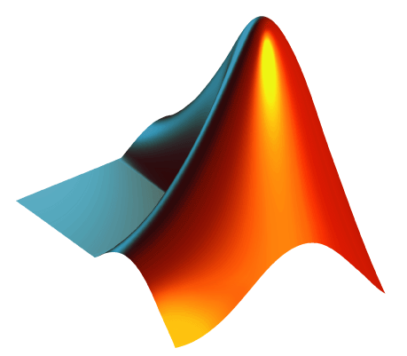
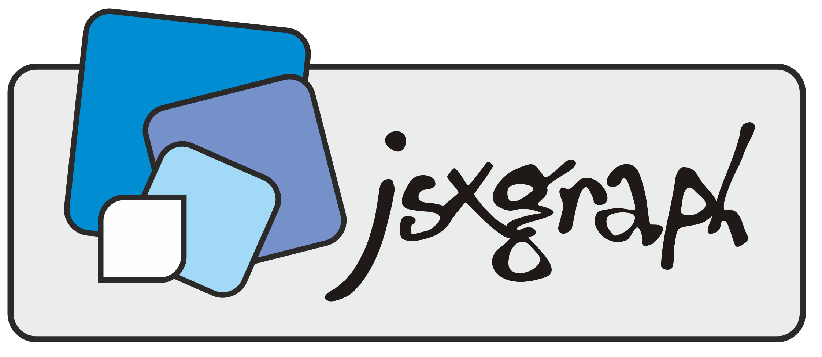
Matlab → JavaScript
Parts of Matlab to recreate
Graphing function easy and clean
Can make stem plots
Compatible with multiple graphs interacting
Compatible with sliders
Reproducing this using JSXGraph
Graphing functionality is clean
No inherent stem plot creator
Might have difficulty getting a graph to recognize and interact with another graph
What tools can we use?
Notes:
++examples of differences in plotting : matlab is more built for this sort of thing so we had to learn how to JSX

Slide 15
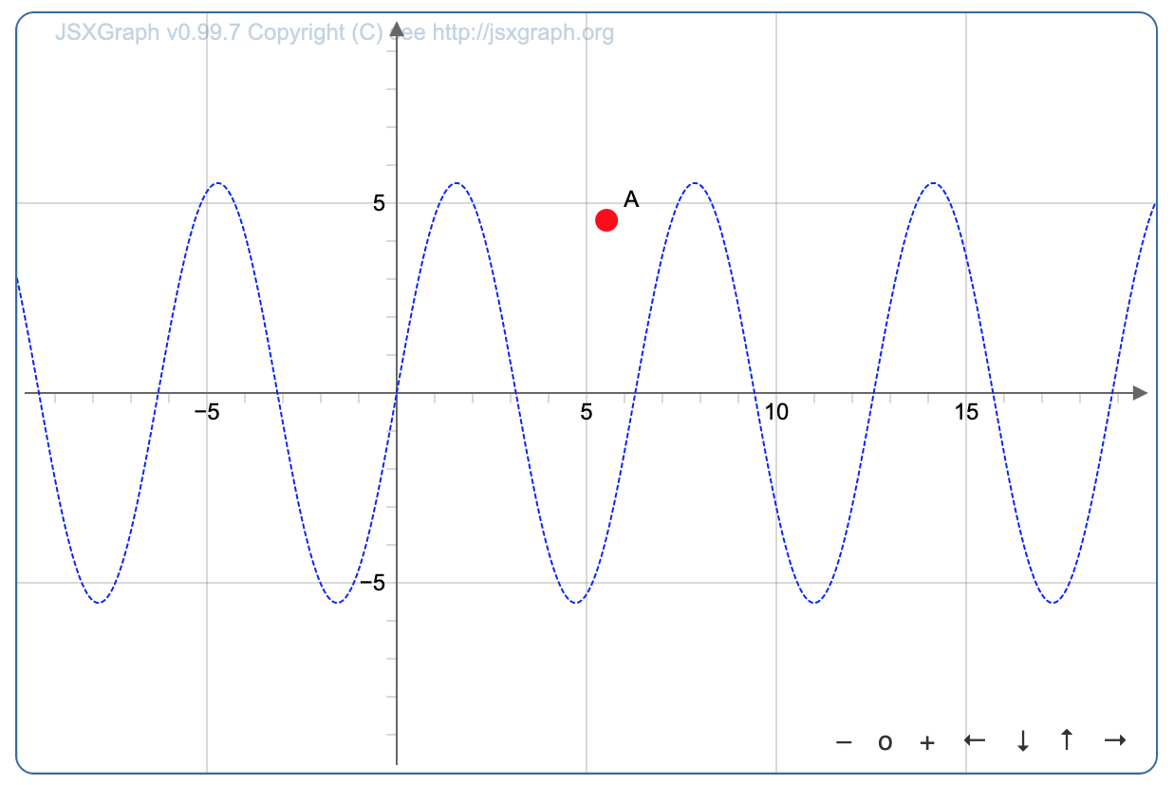
JSXgraph Tools
Points
Curves and Segments
Can input a function f(x)
Can input x coords and y coords
Segments constructed using two endpoints
Notes:
++examples of differences in plotting : matlab is more built for this sort of thing so we had to learn how to JSX
(here are the tools we learned about, how they work, how we used them

Slide 16
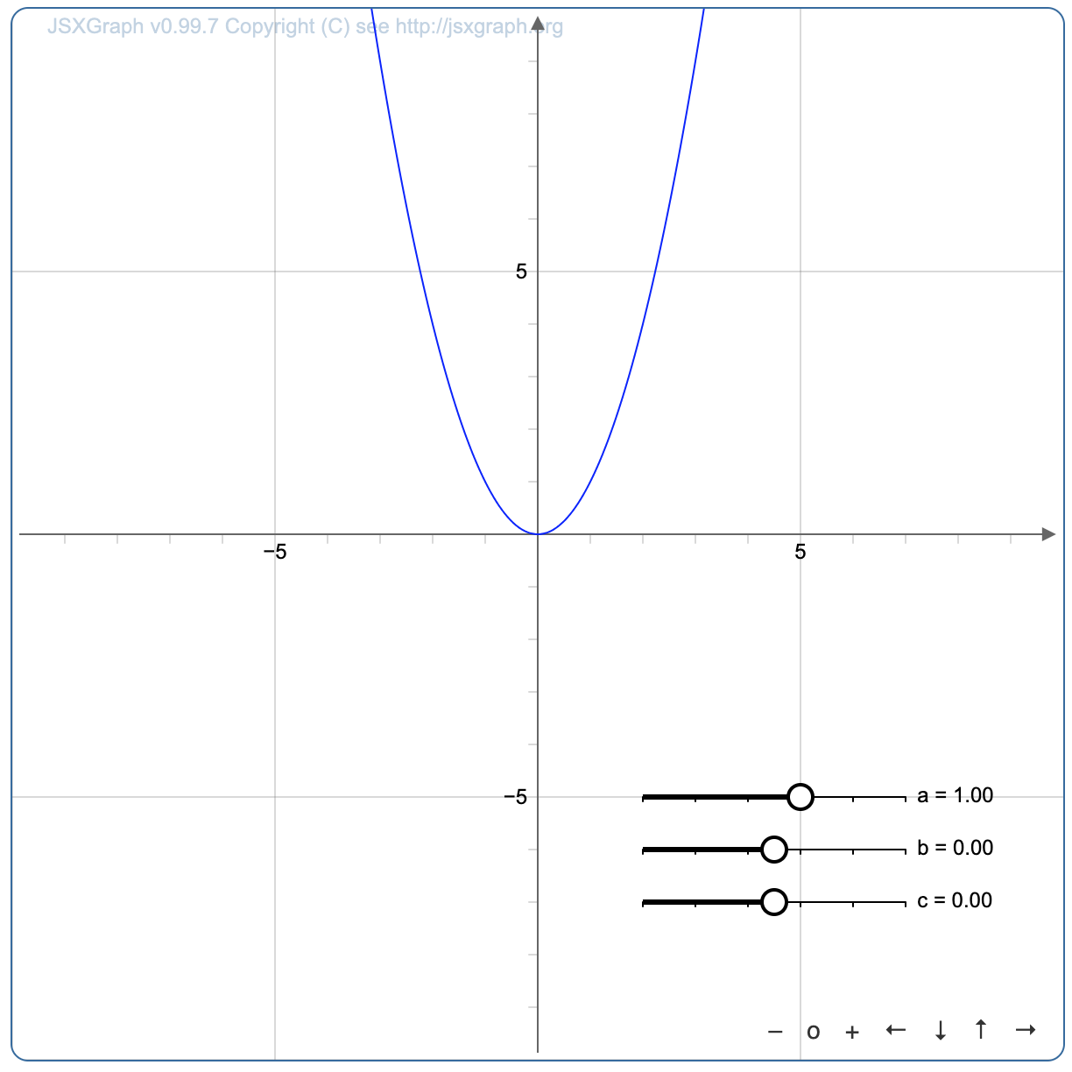
JSXgraph Tools
Sliders
Used to control variables → could be used in plotting curves
Must be located on the graph
Might cause issues if we need another graph to have access to slider values
Notes:
++examples of differences in plotting : matlab is more built for this sort of thing so we had to learn how to JSX
(here are the tools we learned about, how they work, how we used them

Slide 17
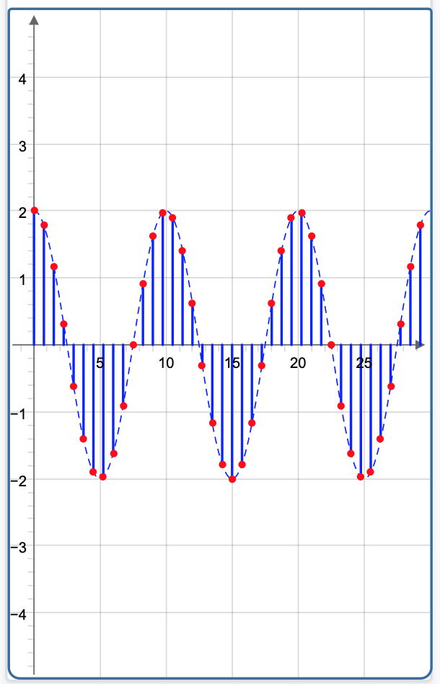
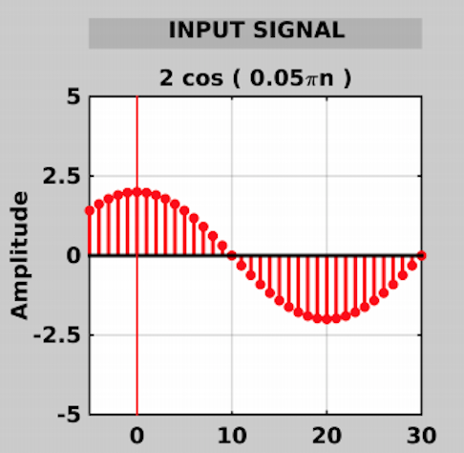
JSXgraph Tools
Each segment is a curve, plotted using a loop.
Can change number of samples in code, but not user modifiable
Actual curve plotted to show where sample values are taken
Notes:
++examples of differences in plotting : matlab is more built for this sort of thing so we had to learn how to JSX
(here are the tools we learned about, how they work, how we used them

Slide 18
JSXgraph Tools
Graphing a curve:
Graphing segments:
Notes:
++examples of differences in plotting : matlab is more built for this sort of thing so we had to learn how to JSX
(here are the tools we learned about, how they work, how we used them

Slide 19
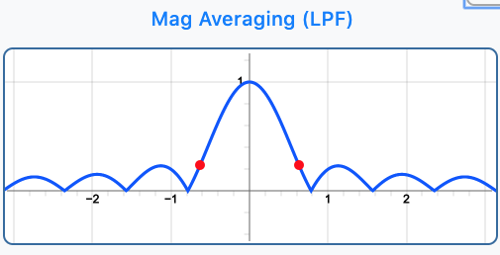
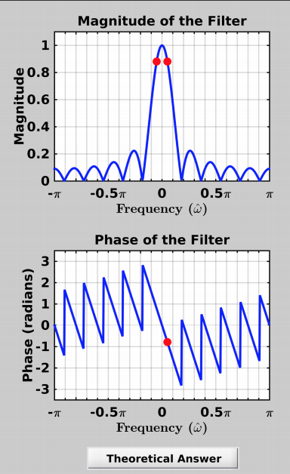
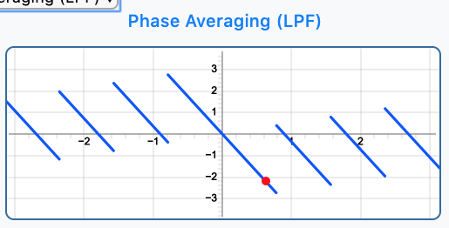
JSXgraph Tools
Plotted using a ‘curve’ object in JSXgraph
Plotted using a ‘curve’ object in JSXgraph
Notes:
As we don’t actually know digital signal processing, we were able to get the formulas for these curves and functions abstracted out, to focus on actual GUI

Slide 20
HTML Tools
Sliders
Can access these from javascript → multiple graphs can access their values
Box input
Allows user to input precise numbers (rounded to the nearest possible slider value)
DropDown
User can select which filter they want use on the input signal
onchange property : when any of the above objects’ values are changed by the user, our graphs can update easily.
Notes:
++examples of differences in plotting : matlab is more built for this sort of thing so we had to learn how to JSX

Slide 21
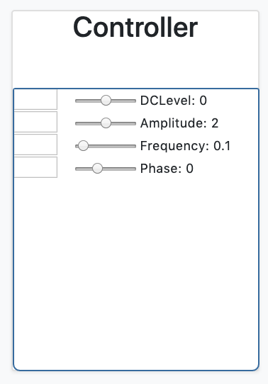
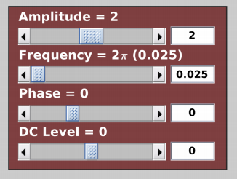
HTML Tools
Text boxes for user input
Current values displayed
Notes:
++examples of differences in plotting : matlab is more built for this sort of thing so we had to learn how to JSX

Slide 22
HTML Tools
Example of using onchange and onclick for a slider and text input
Notes:
++examples of differences in plotting : matlab is more built for this sort of thing so we had to learn how to JSX

Slide 23
Graph Layout Decisions
Ideas to maintain:
Input and output graphs clearly visible
Easy to select filter
Formulas displayed
Manipulatable variables
Ideas to improve:
Minimal scrolling between graphs
Minimal update time
Straightforward usability
Notes:
++ screenshots of original matlab + snippets of our graphs
Initial setup was a bit all over the place: hard to follow, non linear, and not set up as the old demo was
Decided to try and stick to the original, as it made the different components’ purposes excessively clear.
created layout independently of our graphs, which turned out to be perfect for recombining at the end

Slide 24
Graph Layout Decisions
No stem plot
Controllers attached to a specific graph
Notes:
++ screenshots of original matlab + snippets of our graphs
Initial setup was a bit all over the place: hard to follow, non linear, and not set up as the old demo was
Decided to try and stick to the original, as it made the different components’ purposes excessively clear.
created layout independently of our graphs, which turned out to be perfect for recombining at the end

Slide 25
Graph Layout Decisions
Maintain the grouping of graphs
Perhaps place controllers in the middle
Notes:
++ screenshots of original matlab + snippets of our graphs
Initial setup was a bit all over the place: hard to follow, non linear, and not set up as the old demo was
Decided to try and stick to the original, as it made the different components’ purposes excessively clear.
created layout independently of our graphs, which turned out to be perfect for recombining at the end

Slide 26
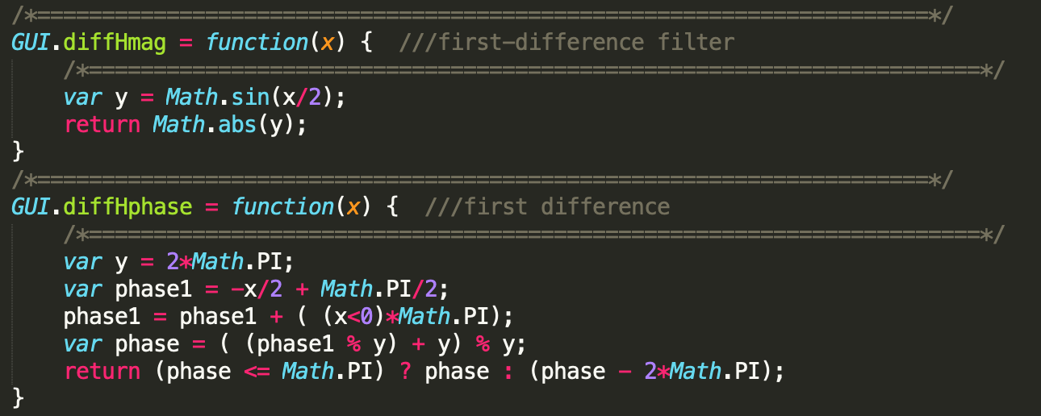
Graph communication
Global data needed:
Values of the sliders
Values modified by the selected filter
Where it was stored:
In the HTML sliders themselves
In a GUI object that stored the filter state
Created variations of the phase and magnitude functions for each filter
Can save a function as an variable in the GUI object when the filter is changed
Notes:
+include output graphs and a bit of code that allows it to communicate with filters
+We didn’t even really need to make graphs communicate other than the output graph & filter graph → the inputs are all the input signal & filter settings

Slide 27
Graph communication
Notes:
+include output graphs and a bit of code that allows it to communicate with filters
+We didn’t even really need to make graphs communicate other than the output graph & filter graph → the inputs are all the input signal & filter settings

Slide 28
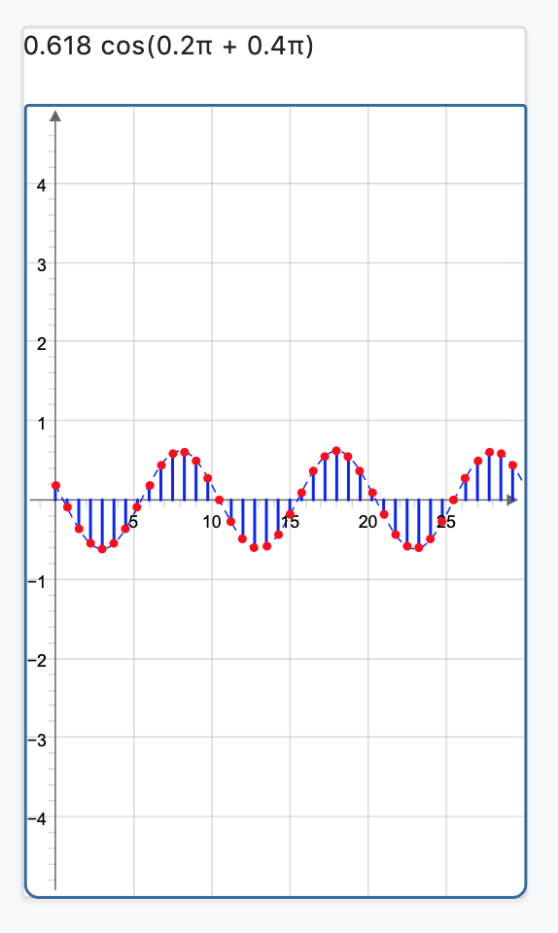
Graph communication
Having figured this out, we could finally move on to putting the project together, layout, graphs, controls and all.
Notes:
+include output graphs and a bit of code that allows it to communicate with filters
+We didn’t even really need to make graphs communicate other than the output graph & filter graph → the inputs are all the input signal & filter settings

Slide 29
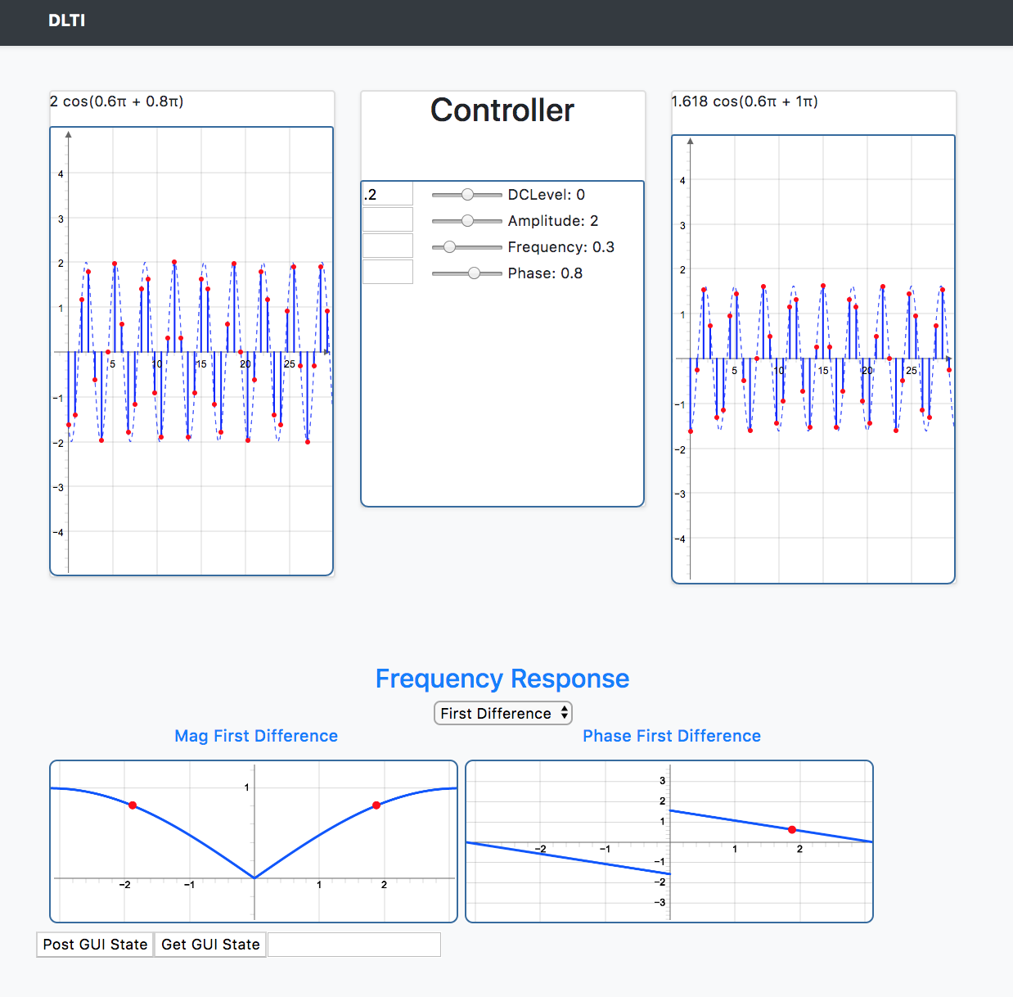
Current Application
Graphs update from sliders/textbox
Pick Filter from dropdown
Strings update from graphs/input

Slide 30
Demo

Slide 31
Future Implementations
Post/Get GUI state
Database for GUI state
Possibly using Python-Flask and SQL to connect everything
Using React as a global controller
Documentation for future teams to work on code

Slide 32
What We Learned
New team and all new to VIP
JavaScript and JSXGraph
Used GitHub more
Work in a group environment

Slide 33
QUESTIONS?

